Slide 1

Data Analytics Capstone Part 1: Python
Tanner Forks

Slide 2

Project Overview:
Movie Dataset Analysis
Budget and revenue analysis
Movie success exploration

Slide 3
Dataset Description:
.csv file
Sizeable yet manageable data size:
4803 rows and 20 columns
After imputation: 3229 rows and 20 columns
Columns used:
Budget, Genres, Homepage, Overview, Release Date, Runtime, Tagline, and Title

Slide 4
Project Implementation Overview:
Basics of data set explored within Jupyter Notebook:
Size and shape of dataset
Null values
Measures of central tendency
Analyzed success metrics for movies:
Top Budgets and Revenues
Correlation of Budget and Popularity
Correlation of Budget and Revenue
Genre effects on Budget/Revenue

Slide 5
Data Treatment:
Importation into Jupyter as .csv file
Null Values:
Majority within irrelevant columns:
Homepage, Overview, Tagline
Imputation of “N/A”
Columns with relevant imputation:
Release Date – 1 row, researched
Runtime – 3 rows, average imputed
Placeholder Values:
Budget and Revenue 0 values
Rows with 0 in either column removed

Slide 6
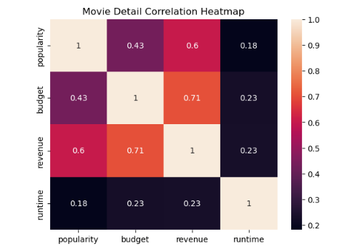
Analysis
Analysis saw a moderately high correlation between revenue and budget (0.71)
Highest budget and revenue movies often coincided
Outliers prevalent within Revenue column, but retained (next slide)
Top Budgets and Revenues

Slide 7
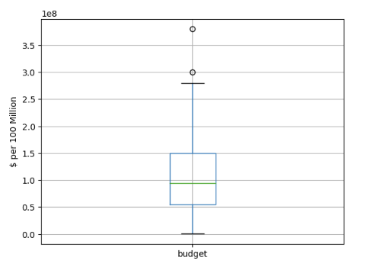
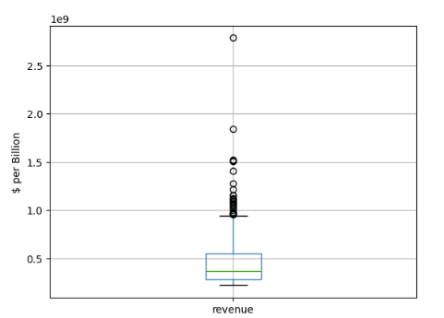
Analysis
Budget and Revenue Outlier Display

Slide 8
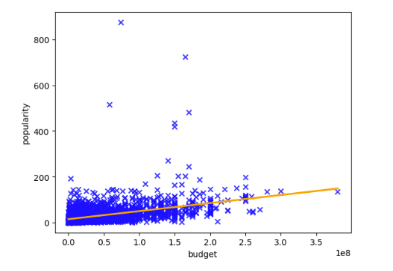
Analysis
Budget and popularity had only slightly moderate correlation (0.41)
Data points at high popularity but low budget
What does this mean?
Budget not always indicative of quality
Budget and Popularity

Slide 9
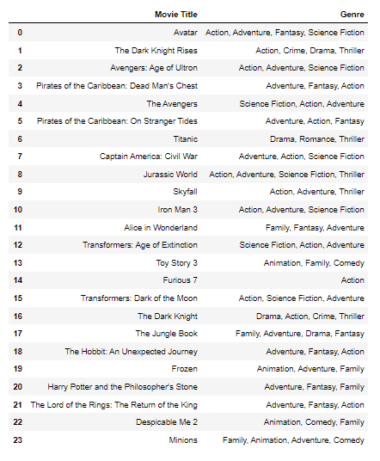
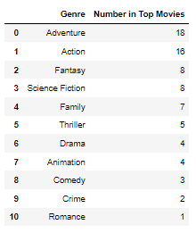
Analysis
Another Consideration: Genre
Popular genres in top revenue movies ($961m and above)
Compare popular genres with list
Genre Popularity

Slide 10
Challenges Overview:
Data Format:
Lists and Dictionaries
Code Generalization
Repetitiveness and solution
Question Interpretation:
“Categories” within data set

Slide 11
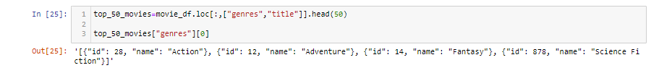
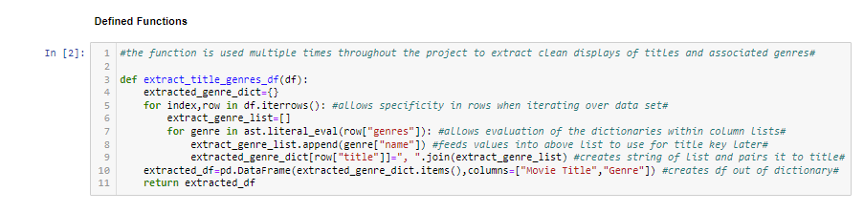
Challenge: Data Format
Lists of Dictionaries
Solution:
Coding to isolate necessary Data
Aesthetic concerns and accessibility

Slide 12
Challenge: Code Generalization
Repetitive use of similar code
Especially tasks with similar requests
Solution: Defined functions

Slide 13
Challenge: Question Interpretation
Categories not specified within data
Solution: Extract Titles and Genres
Using defined function
Most specific information available
Pictured: Top Revenue movies and genres

Slide 14

Conclusion:
Individual predictions will require further consideration:
Better analysis of genre popularity to predict success
Further treatment of popularity/revenue outliers
Overall: data analyzed reinforces caution with expected revenue from budget
More budget toward better resources
No guarantees

